Slide 1

Project Report (221DBAVAC6)
(For the partial fulfillment of award of Degree of PGDBA from Department Of Management)
“Loan Approval Prediction using Machine Learning”
Submitted by
Supervised by
Mohit
Department of Management Studies Gurugram University
Mrs. Manisha
Trainer
Jan 2023
GURUGRAM UNIVERSITY, GURUGRAM
Mayfield Garden, Sector 51, Gurugram, Haryana 122003 Session 2022-2023

Slide 2
Student's Declaration
I hereby declare that the Project Work with the title (in block letters) “Loan Approval Prediction Using Machine Learning” submitted by me for the partial fulfillment of the degree of PGDBA, Gurugram University is my original work and has not been submitted earlier to any other University /Institution for the fulfillment of the requirement for any course of study.
I also declare that no chapter of this manuscript in whole or in part has been incorporated in this report from any earlier work done by others or by me. However, extracts of any literature which has been used for this report has been duly acknowledged providing details of such literature in the references.
Signature
Name: Mohit
Registration No.
Place: GURUGRAM
Date:

Slide 3
We are using this opportunity to express my gratitude to everyone who supported us throughout this group project. We are thankful for their aspiring guidance, invaluably constructive criticism, and friendly advice during the project work. I am sincerely grateful to them for sharing their truthful and illuminating views on some issues related to the project.
Further, we were fortunate to have Mrs.Manisha as our mentor. She has readily shared his immense knowledge in data analytics and guides us in a manner that outcome resulted in enhancing our data skills.
We certify that the work done by us for conceptualizing and completing this project is original and authentic.
Date: May 28,2023
Place: Gurugram, Haryana
Acknowledgments

Slide 4
Introduction

Slide 5
LOANS are the major requirement of the modern world. By this only, Banks get a major part of the total profit. It is beneficial for students to manage their education and living expenses, and for people to buy any kind of luxury like houses, cars, etc.
But when it comes to deciding whether the applicant’s profile is relevant to be granted with loan or not. Banks have to look after many aspects.
So, here we will be using Machine Learning with Python to ease their work and predict whether the candidate’s profile is relevant or not using key features like Marital Status, Education, Applicant Income, Credit History, etc.

Slide 6
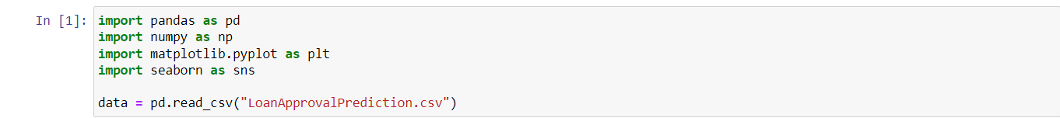
Importing Required libraries

Slide 7
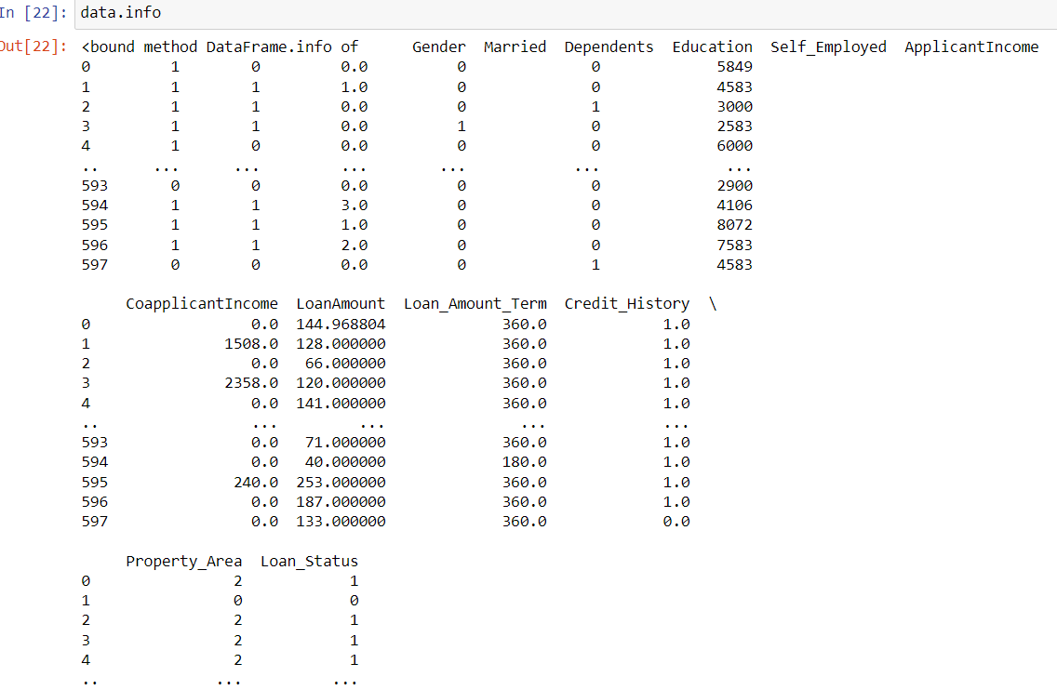
Data Preview

Slide 8
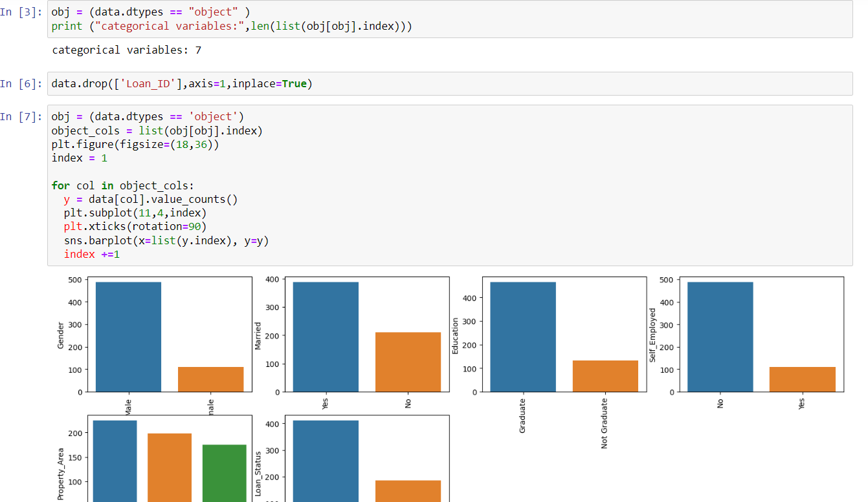
Data Preprocessing and Visualization

Slide 9
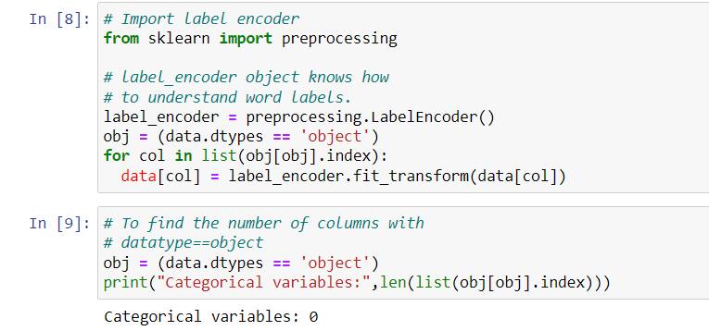
As all the categorical values are binary so we can use Label Encoder for all such columns and the values will change into int datatype.

Slide 10
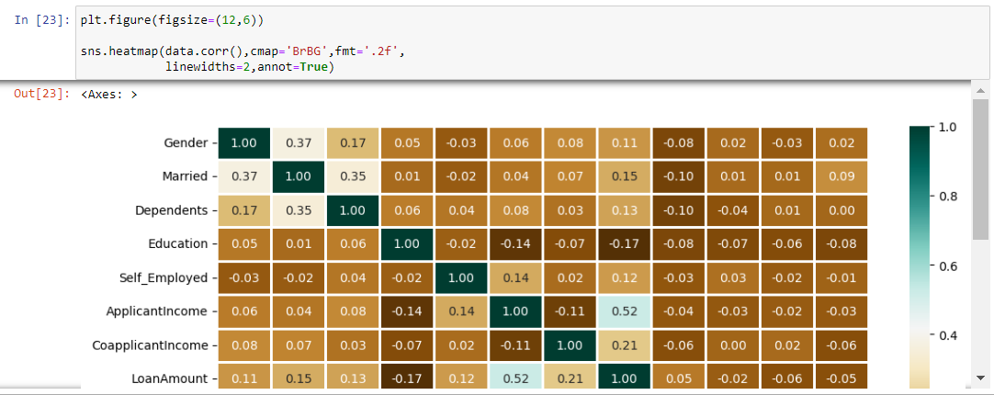
Heatmap is showing the correlation between Loan Amount and ApplicantIncome. It also shows that Credit_History has a high impact on Loan_Status.
Now we will use Catplot to visualize the plot for the Gender, and Marital Status of the applicant.

Slide 11
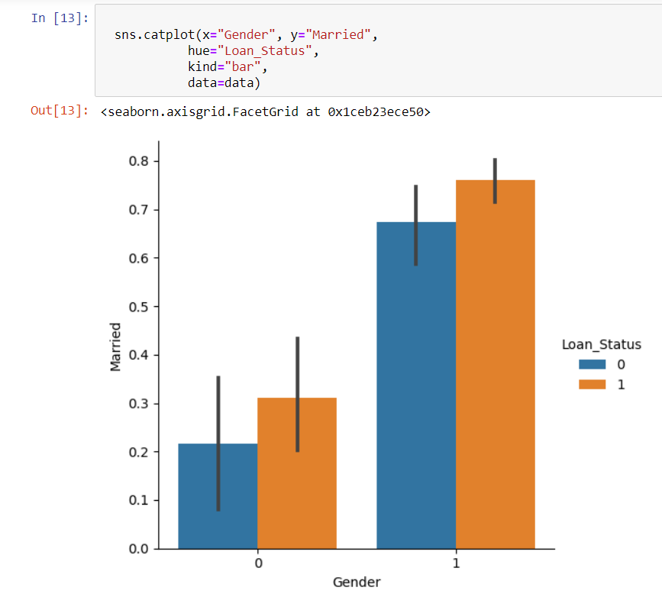
Gender and Marriage status of Applicant

Slide 12
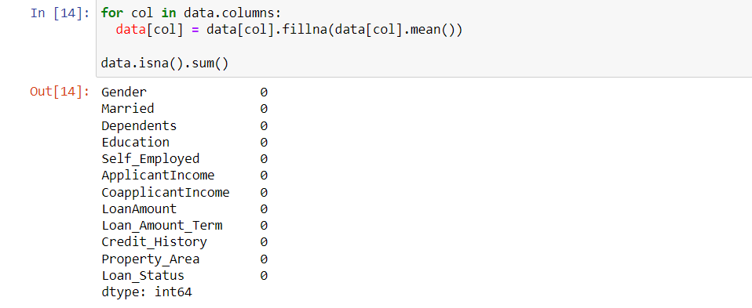
Now we will find out if there is any missing values in the dataset using below code.

Slide 13
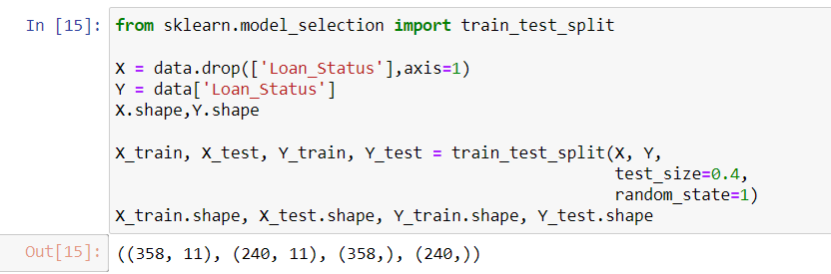
Splitting Dataset

Slide 14
Model Training and Evaluation
Model Training and Evaluation
As this is a classification problem so we will be using these models :
RandomForestClassifiers
Support Vector Classifiers (SVC)
Logistics Regression
To predict the accuracy we will use the accuracy score function from scikit-learn library.

Slide 15
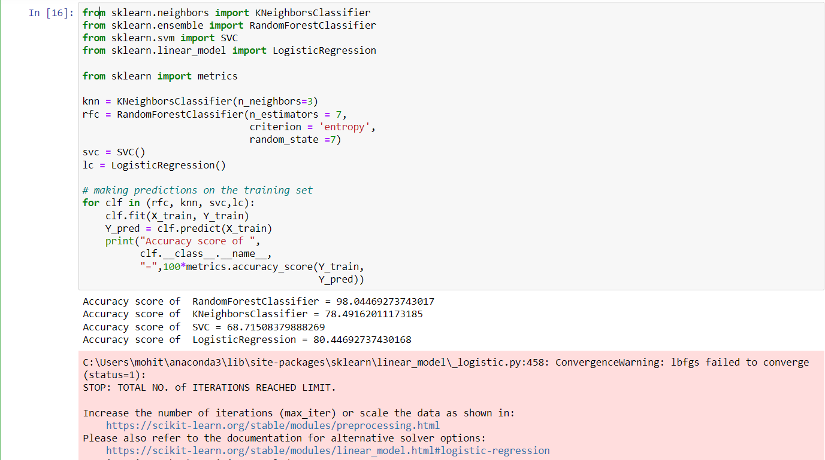
Model Training and Evaluation with codes

Slide 16
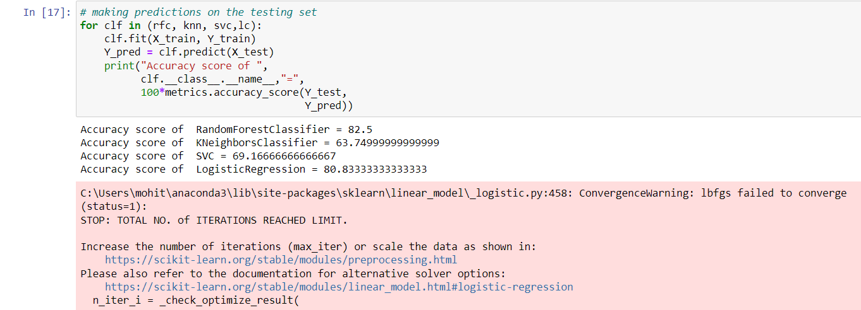
Prediction on the test set:

Slide 17
Conclusion
Random Forest Classifier is giving the best accuracy with an accuracy score of 82% for the testing dataset. And to get much better results ensemble learning techniques like Bagging and Boosting can also be used.
Loan companies grant loans after a thorough verification and validation process. However, they do not know with absolute certainty whether the applicant will be able to repay the loan without difficulty. The loan Prediction System will allow them to choose the most deserving applicants quickly, easily, and efficiently. It may provide the bank with unique benefits. In this paper, we have reviewed the process of building a Loan Approval Prediction System. Data collection, Exploratory Data Analysis, Data Preprocessing, Model Building, and Model Testing are the analytical processes involved in building this system. We conducted a thorough review of the previous research papers in this field in this paper. The most widely used algorithms, such as Logistic Regression, Decision Tree, and Random Forest Technique, have been examined and reviewed in greater depth.

Slide 18
RECOMMENDATION
AND
REFERENCES

Slide 19
Data Source
https://drive.google.com/file/d/1LIvIdqdHDFEGnfzIgEh4L6GFirzsE3US/view
Important Libaries
RandomForestClassifiers
Support Vector Classifiers (SVC)
Logistics Regression
Pandas
Numpy
Matplotlib.pyplot
Seaborn

